Slide 1
Using Multi-Agent Systems for real with Netlogo
3.9. Voting Sensitivity
05/11/2022
An assignment by:
199900072 – João Queirós
201909156 – José Pinto

Slide 2
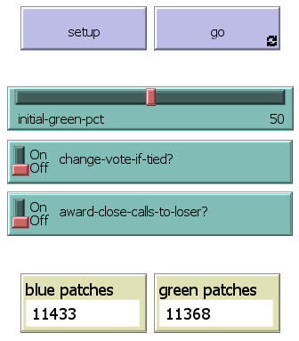
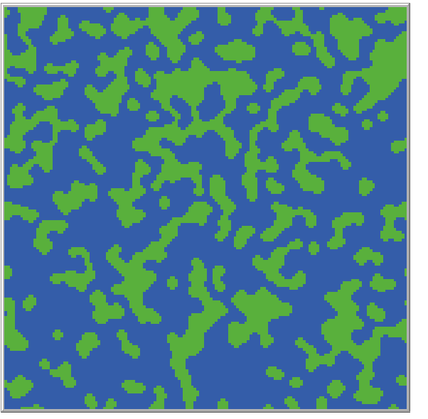
A. Analyse the model chosen and run it with a basic setup
2.9 Voting Sensivity
User Interface
The Basic model is a two-party model allows the user to:
Choose the initial percentage of the “green” party
Determine if the vote changes in case of a tie
Award close calls to loser party
Operating mode
Each “Patch” sums the votes of his 8 neighbours and changes the vote to the party most voted.
If the “change-vote-if-tied” is active, in case of a tie, the patch changes his vote.
If the “Awd-Close-calls-loser” is active, in case a party looses with 3 votes, it still wins.
0 | 1 | 1
0 | ? | 0
1 | 1 | 1
Next vote?
SumNeighb = 5
As SumNeighb > 4
then vote = green

Slide 3
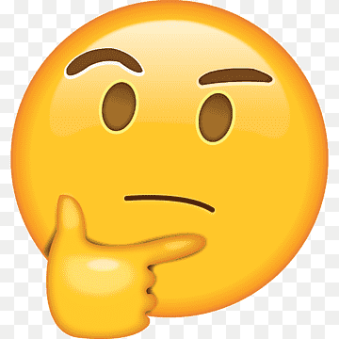

B. Fit the model to a real situation
Changing the model to a 4-party system like the former Portuguese political scenario
Next Vote Determination
Randomness effect
Each patch changes its vote to the party with most votes.
if viziPsd > viziPs [
if viziPsd > viziPcp [
if viziPsd > viziCds [
set next-vote votaPsd ...
Problem: ties
To solve the ties and to give unpredictability to the system a random effect is included. User can determine uncertainty in a 1-100 scale
to cria-aleatoridade
set viziPs viziPs * (1 - (random incerteza / 100 ))
set viziPsd viziPsd * (1 - (random incerteza / 100 ))
set viziPcp viziPcp * (1 - (random incerteza / 100 ))
set viziCds viziCds * (1 - (random incerteza / 100 ))
end
PS | PSD | PSD
PCP | ? | CDS
PSD | PCP | PS

Slide 4


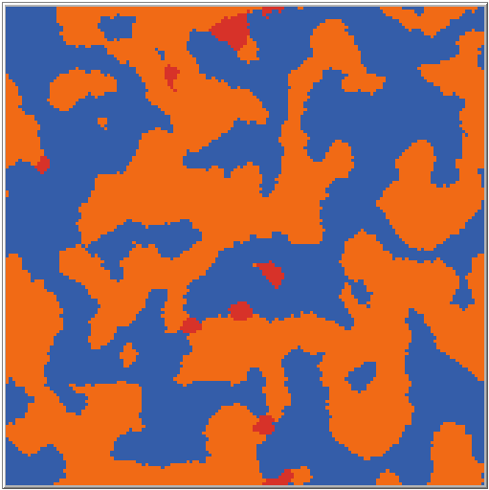
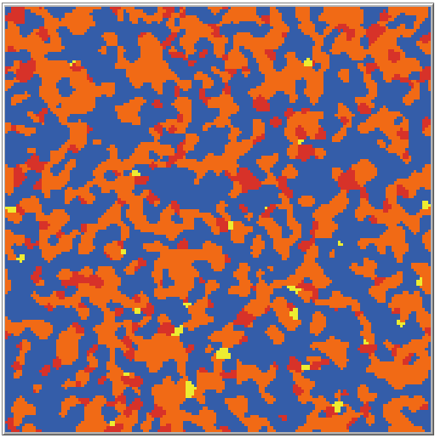
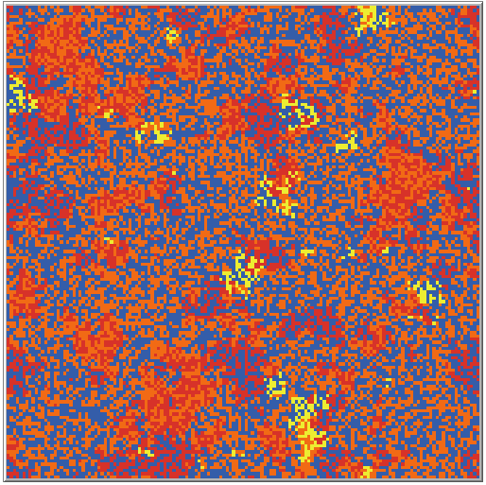

B. Fit the model to a real situation
Including a loyalty effect
Elector voting loyalty
User can decide voting loyalty in -5 to 10 scale
to atribui-lealdade
(
ifelse
vote = votaPs [set viziPs viziPs + lealdade]
vote = votaPsd [set viziPsd viziPsd + lealdade]
vote = votaPcp [set viziPcp viziPcp + lealdade]
vote = votaCds [set viziCds viziCds + lealdade]
)
end

Slide 5




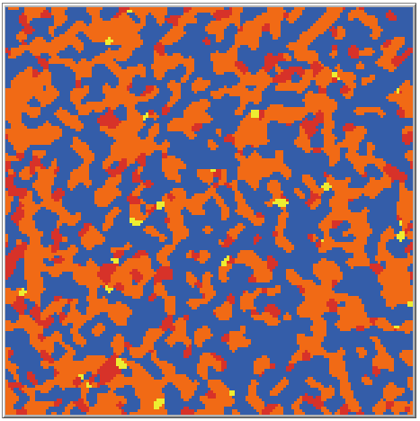
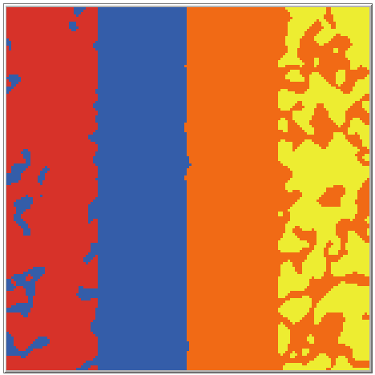
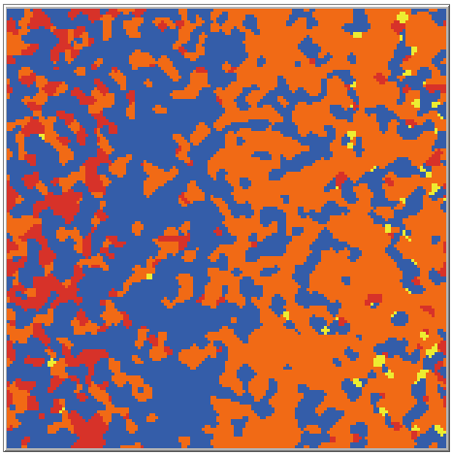
B. Fit the model to a real situation
Including Political orientation on the setup
Political orientation influences the vote
Strategy of the parties also influences
If the patch is in the left half of the screen, it will favor “left” parties, otherwise the “right” parties
ifelse pxcor < centro-politico [
set viziPs viziPs + peso-orientacao-politica / 50
set viziPcp viziPcp + peso-orientacao-politica / 50
A party can target the center (and lose influence on the extremes)
if pxcor > -37.5 and pxcor < 37.5
[if catch-all[set vizi vizi + p-orient-pol / 50] ...
if pxcor > 37.5
[if NOT catch-all[set vizi vizi + p-orient-pol / 60]

Slide 6
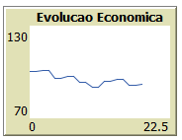
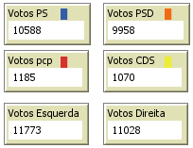

B. Fit the model to a real situation
Adding economy to the equation – Party in Power consequences
Economic behaviour affects the voting
Party in Power is affected by economy
Each tick economics and party in government are updated
to update-economia
let variacao random 10 - 5
...
set eco eco + variação
to update-partido-poder
let votos-psd count patches with [vote = votaPsd]
...
(ifelse
max-votos = votos-psd [set partido-poder Psd]
...
)
If economy above 100 it benefits party in power and party from the same politic family
let pond-eco (peso-eco * ((econo - 100) / 200 ))
ifelse
partido-poder = Ps or partido-poder = Pcp[
set viziPs viziPs + pond-eco
set viziPcp viziPcp + pond-eco ]

Slide 7
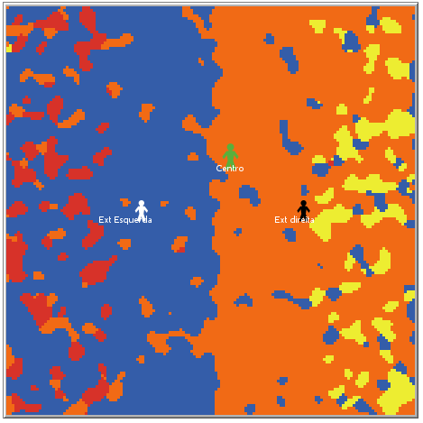
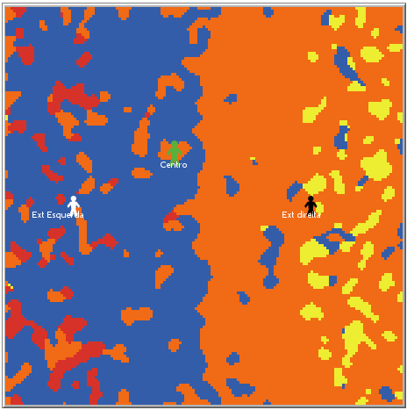


B. Fit the model to a real situation
Combining political orientation and Economy
Economy affects the voters political orientation
If economy is good (> 100) then:
Voters shift to right
And extremes are less favored
If economy is bad (< 100) then:
Voters shift to the left
And extremes are favored
let ecopower ((100 - economia ) / 100) * -3.33
set centro-politico peso-economia-espectro * ecopower * (-1)
set limiar-ext-direita 75 - (75 - centro-politico) / (2 + ecopower)
set limiar-ext-esquerda -75 - (-75 - centro-politico) / (2 + ecopower)

Slide 8
C. Complement the study with scientific articles that may help justify some decisions
Lidia Gonçalves Veiga e Francisco José Veiga – Portugal a Votos, As Eleições Legislativas de 2002.
Even the most rational voters make their voting decision based on readily available information, voting for the ruling party if economic performance is satisfactory, and for the opposition parties if not (Downs, 1957, Kramer, 1971, Frey and Schneider, 1978).
Economics, Elections, and Voting Behavior Suzanna Linn, Jonathan Nagler, and Marco A. Morales
… voters in a recession might prefer the Democratic party, thinking it would be more likely to pursue expansionist fiscal and monetary policy than the Republican party.
… voters reward incumbents for good times, and punish them for bad times…

Slide 9

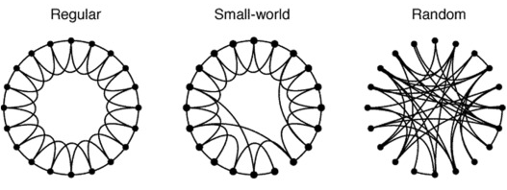
D. Use of networks concepts
The Model works with different network settings
Increasing randomness →
The model allows to select different network typologies:
Regular network (influenced by neighbors)
Small-World network (influenced by both neighbors and random voters)
Random network (influenced by random votes
to conta-votos-patches-aleatorios
let incremento-por-patch 0.5
let i o
while [i < 8][
let outro one-of patches
(ifelse
([vote] of outro) = votaPsd [set viziPsd viziPsd + incremento-por-patch]
...
)
set i i + 1
]

Slide 10
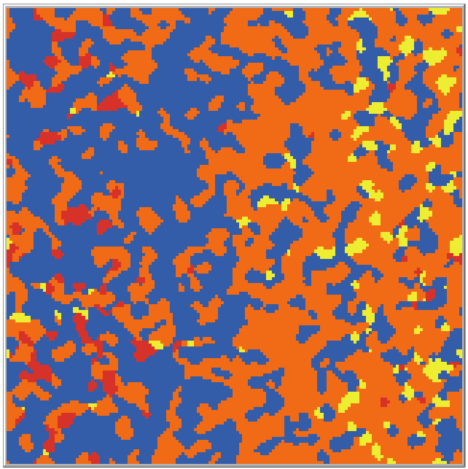

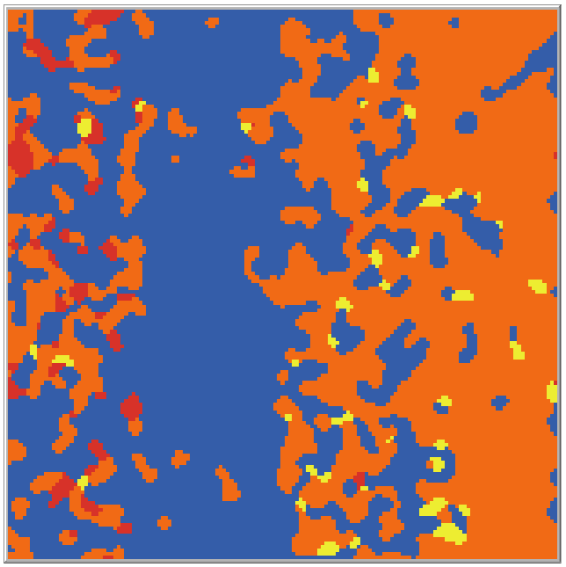

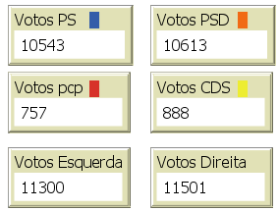
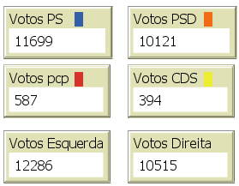
E. Running the “new” model
Case Study - Results
What happens when a party does not target the center
Scenario 1
Scenario 2
Conclusion:
By abandoning the center, a party loses the “center-right” votes to the other “catch-all-party”, and “steals” votes from the other party in their political side.

